Slide 1
Progress report Solar telescope
July 10, 2024
Hina Suzuki

Slide 2
Project goals review
1. Implementation of Solar finder
No solar finder is implemented to the solar telescope located outside of the visitor center.
When visitors align the solar telescope to the Sun, it require visitor to look up the Sun directly and point telescope to it.
Solar finder is needed to point the Sun more accurately without damaging users eyes.
2. Improvement on Indicator
3V voltmeter was implemented as a indicator, however it does not clearly show difference on radio emission from the Sun and from ground/cold sky.
We aim to improve indicator (e.g. speaker) to make this more apparent and attractive.

Slide 3
Solar Finder

Slide 4
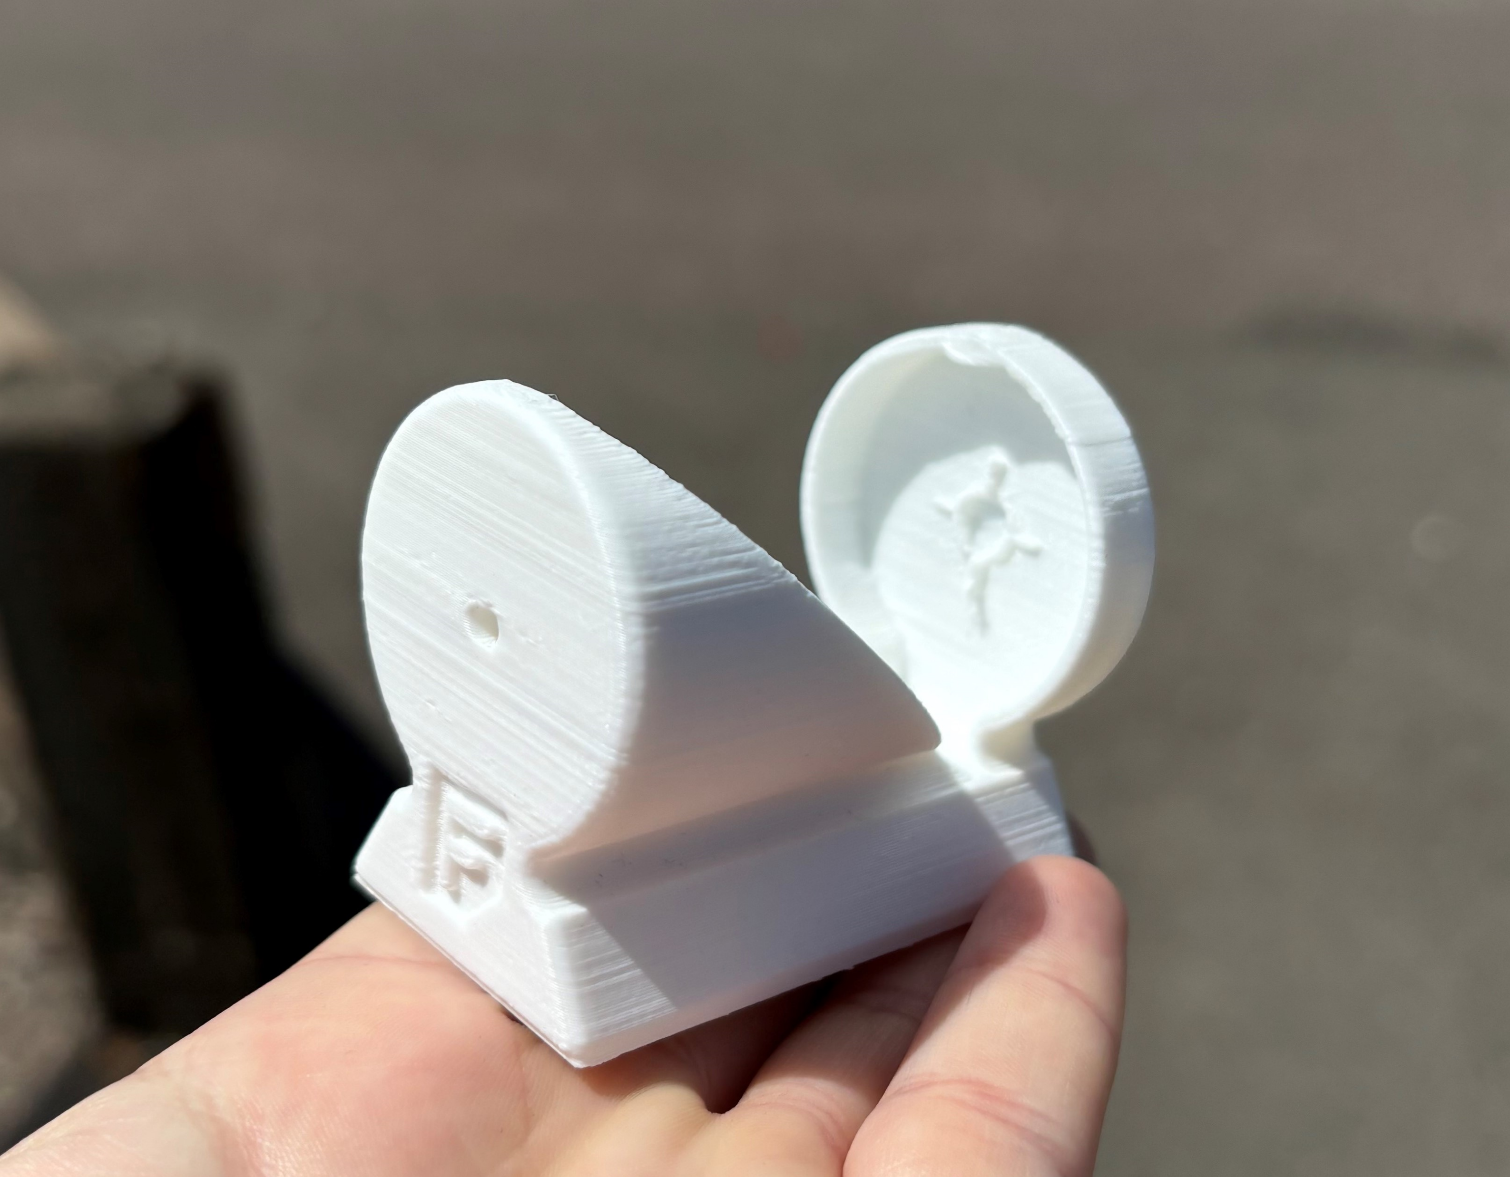
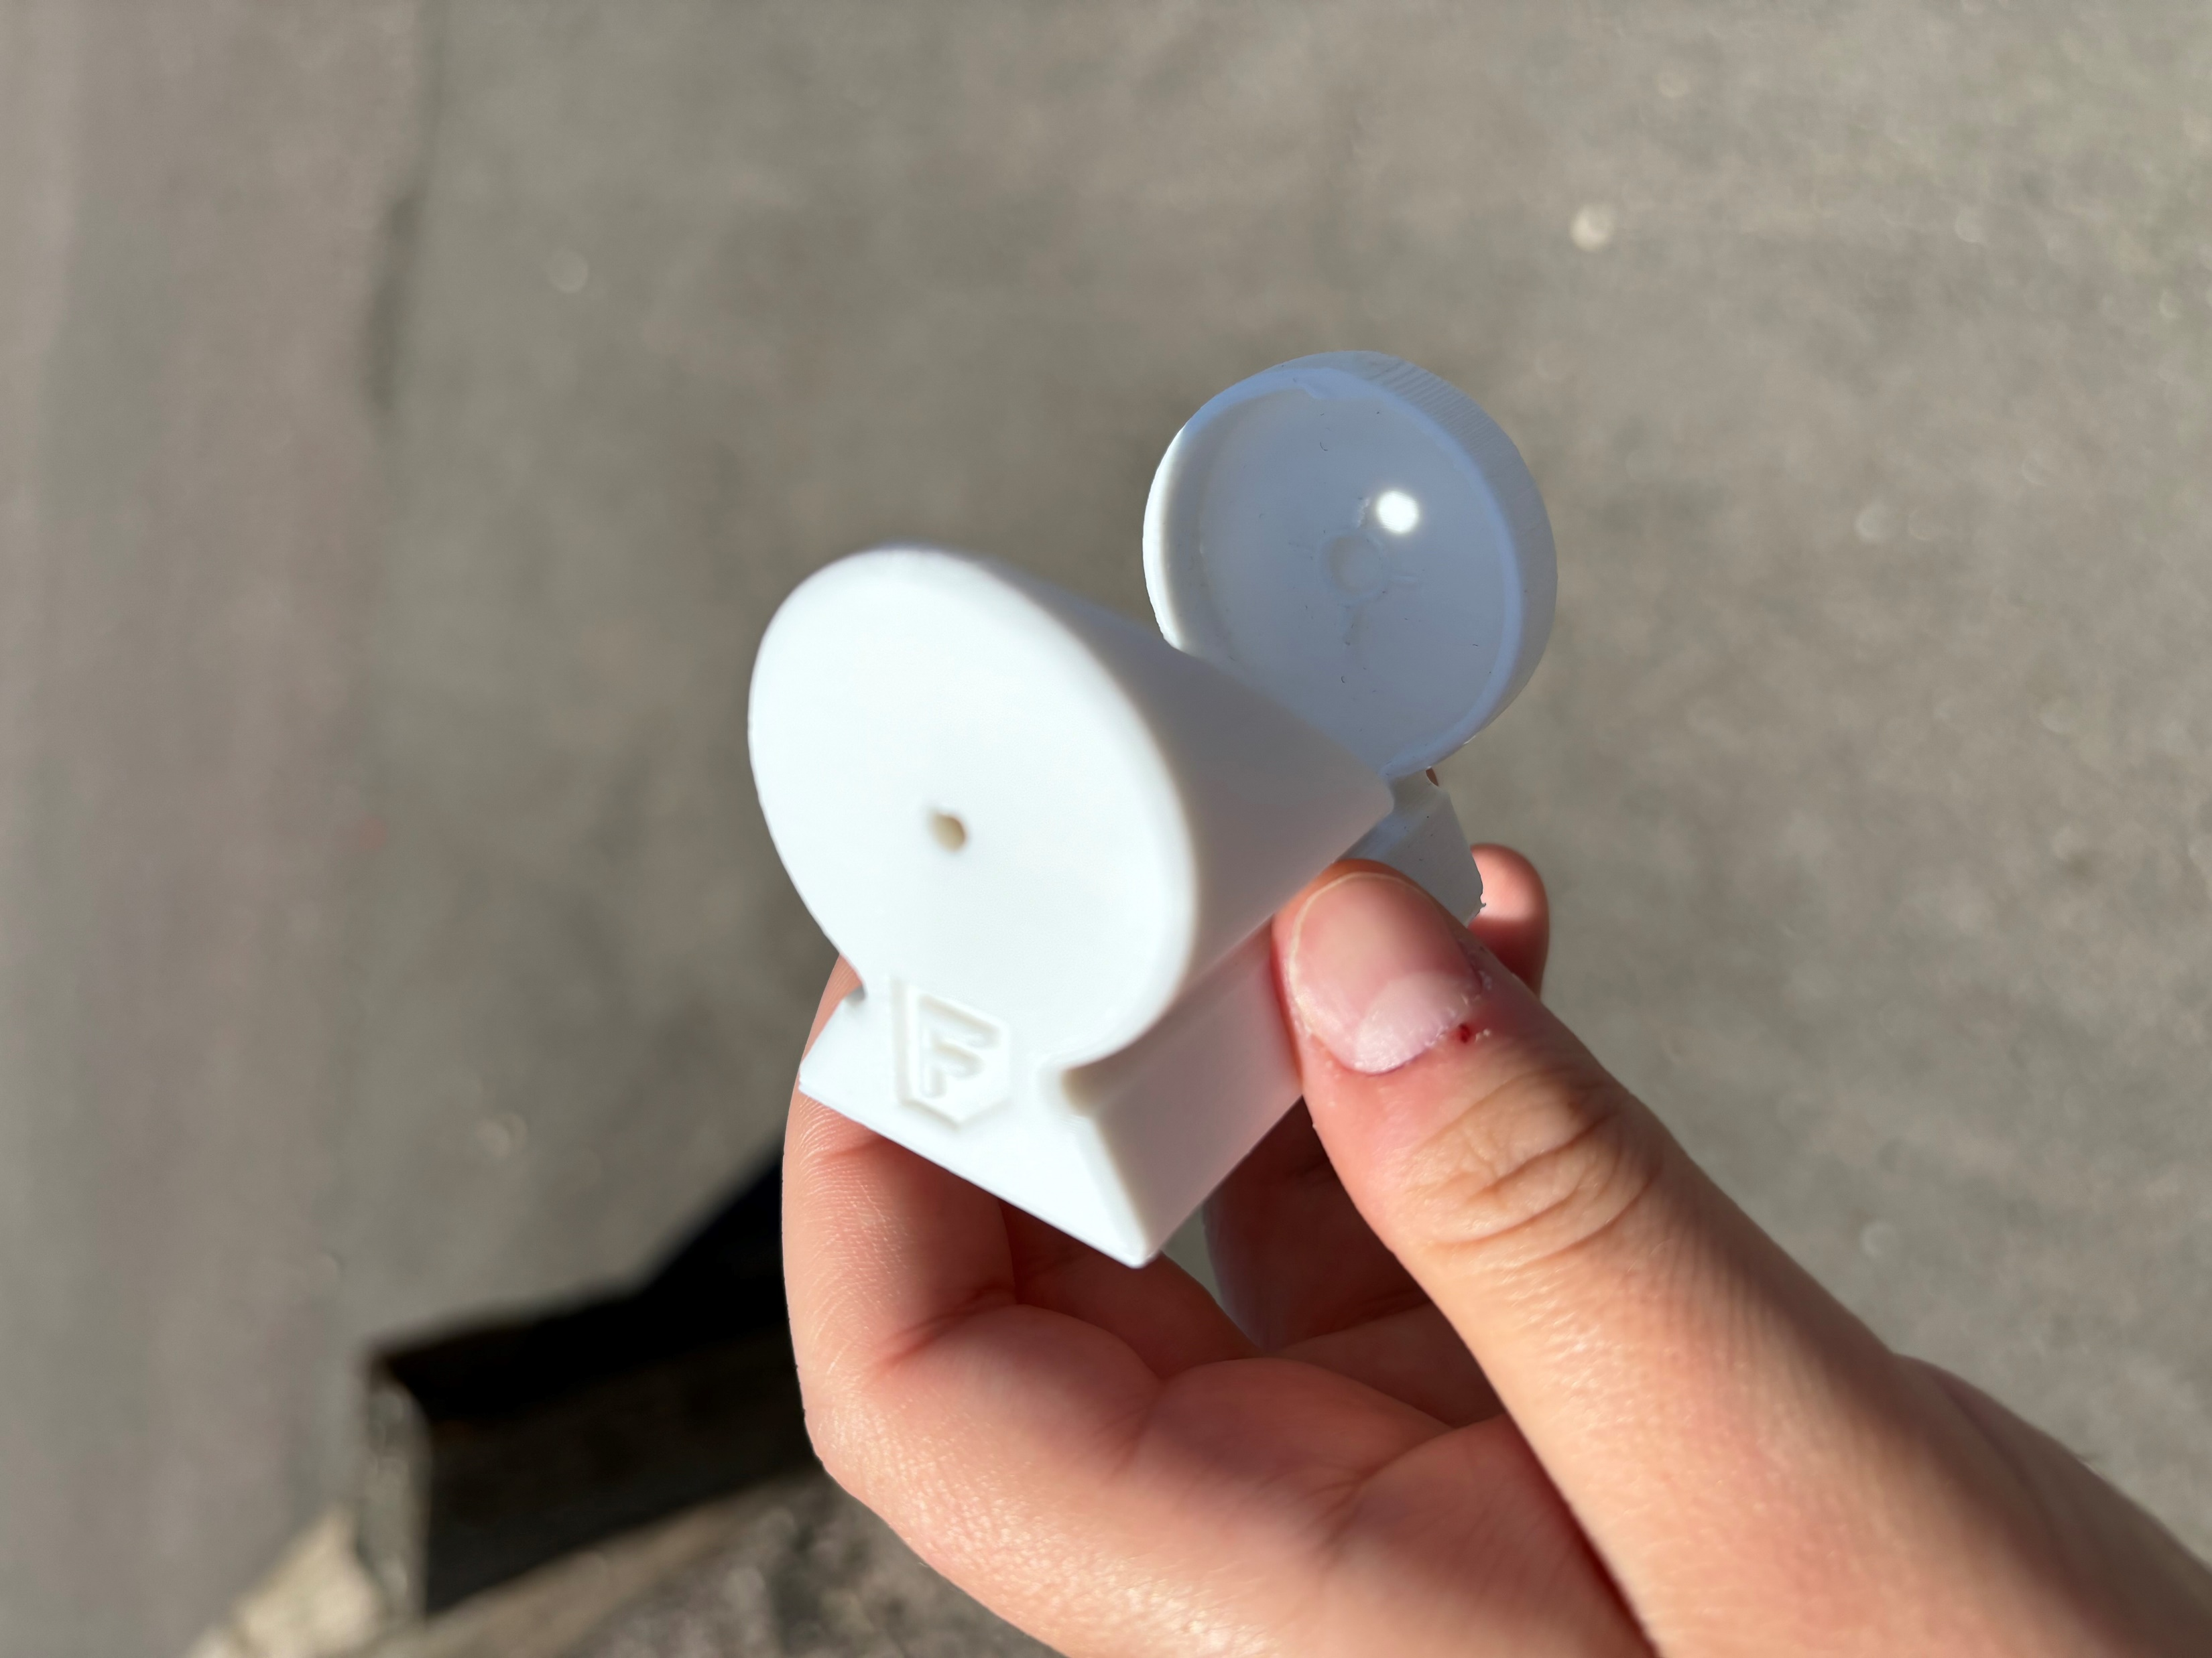
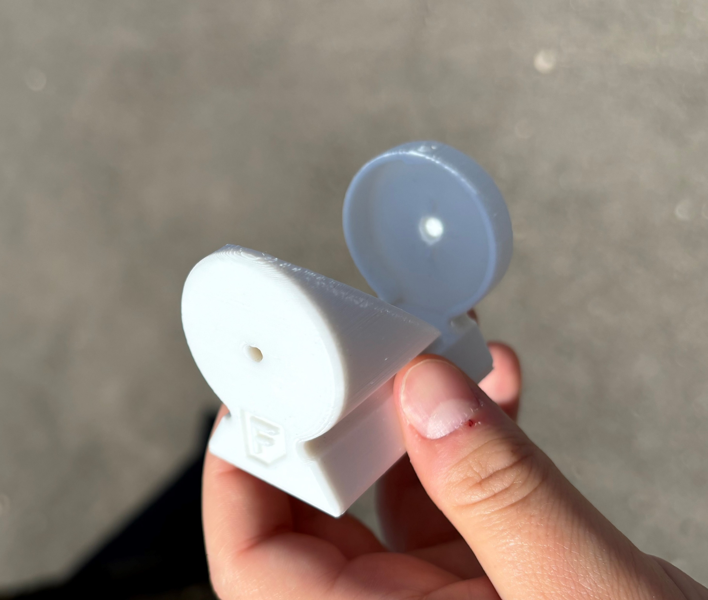
Progress Solar finder
Print prototype
Test functionality
Measurement of telescope mounting position
3D model mounting attachment
Installation

Slide 5
Future work for this summer
Measurement of telescope mounting position ( - 7/19 )
Check durability of the material we have (- 7/19 )
3D model mounting attachment (- 7/26)
Installation & demo ( - 8/9 )

Slide 6
Indicator Improvement

Slide 7
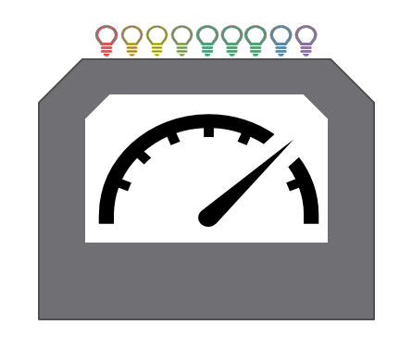
Progress Indicator, LED
Electric Schematic diagram
PCB design with mounting dimension
Order parts
Order board ( This week )
( 2 weeks ) test parts functions on breadboard
Board and parts arrival
Assembling
Test behavior
Adjustment and installation

Slide 8
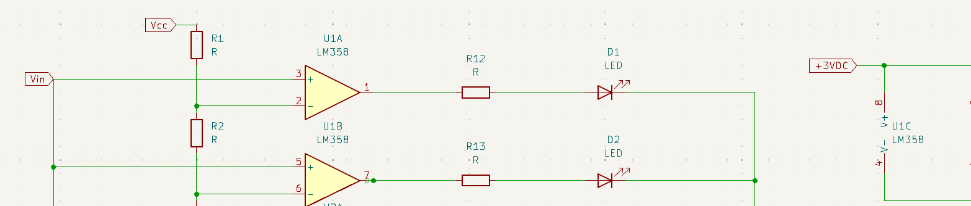
LED design
Same resistor values for voltage divider for inverting input pin
-> liner response
The top resisters the bigger value
-> log, non liner response
Parts (LED & Op amp) are ordered
by Remy
Arrived !

Slide 9
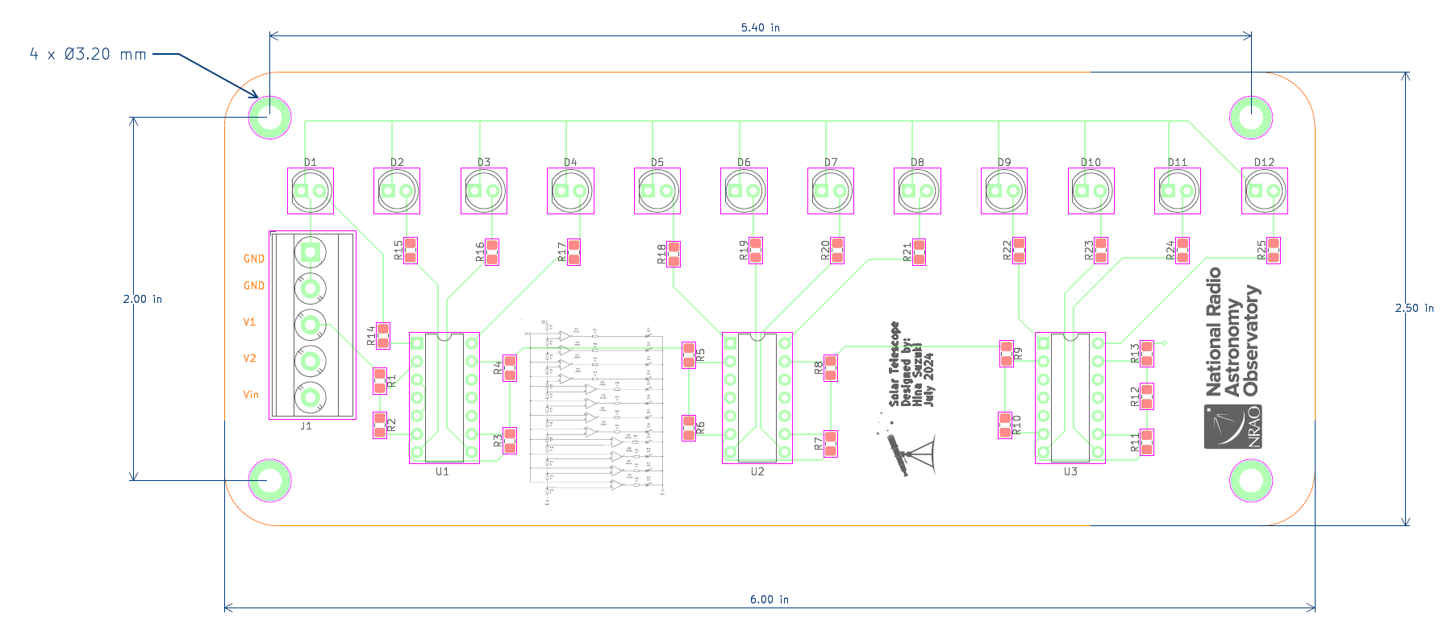
PCB board design

Slide 10
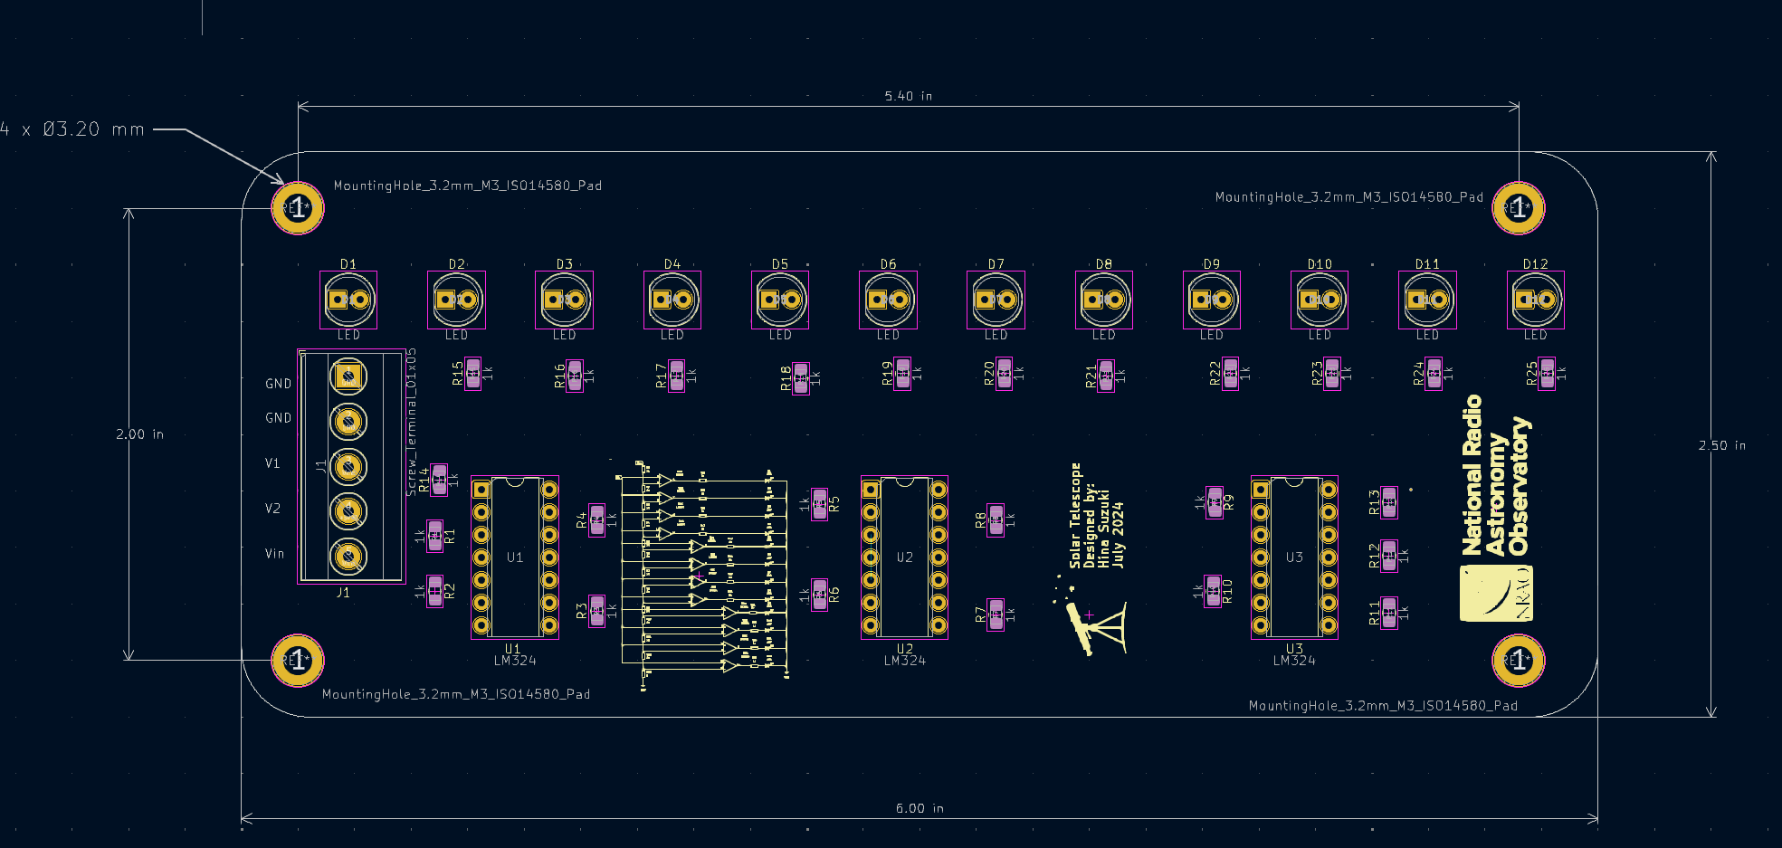
PCB board design

Slide 11
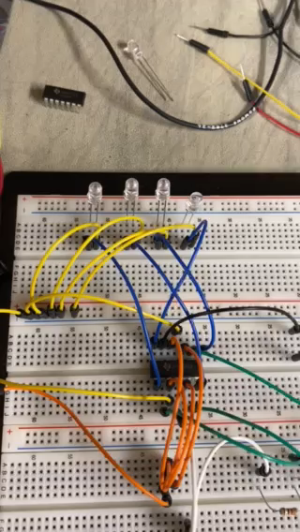
Future work for this summer
Order PCB board ( - 7/12 )
Test parts functions on breadboard ( - 7/18 )
Order mechanical team to mounting system ( - 7/26 )
Boards arrival ( - 7/26 )
Assembling (- 7/31)
Installation & testing ( - 8/9 )

